Slide 1
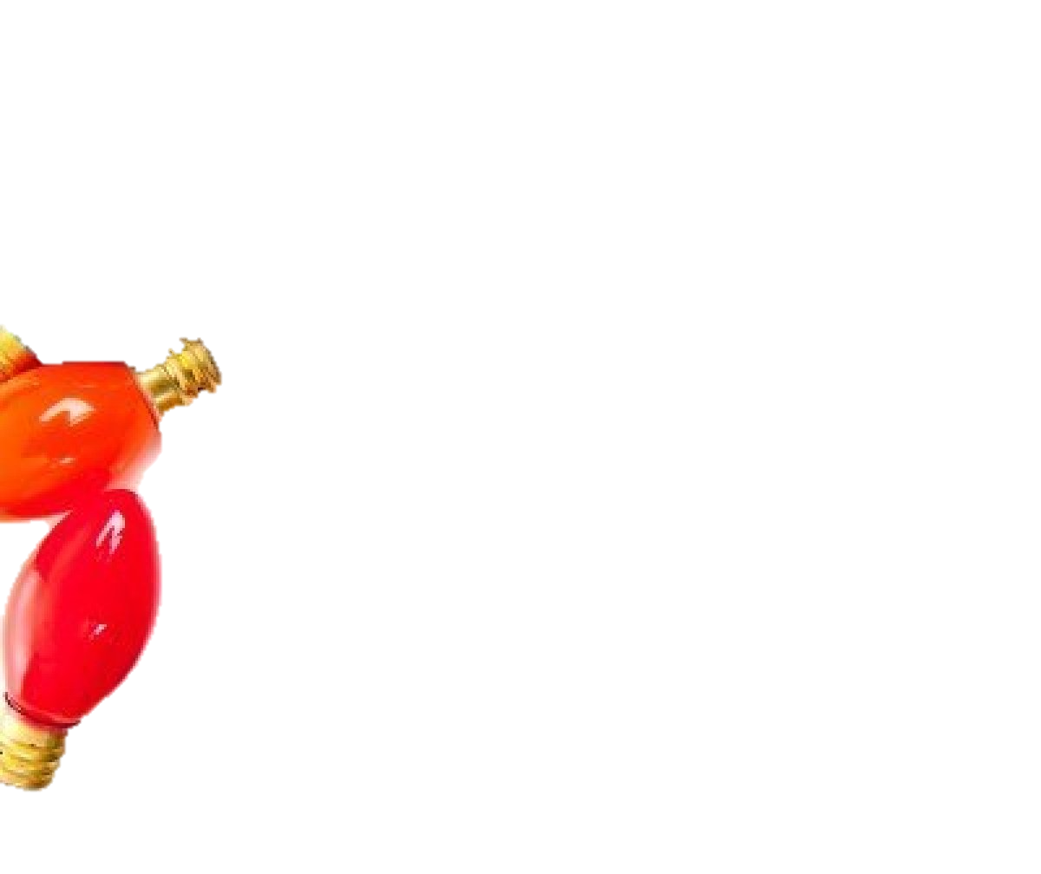
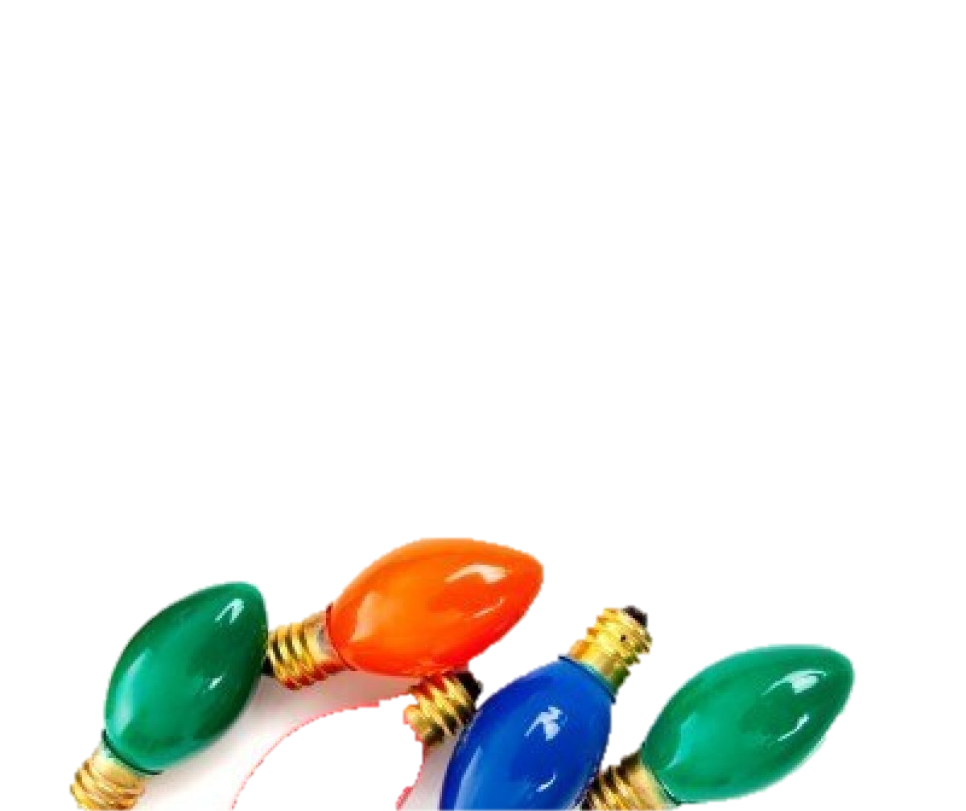
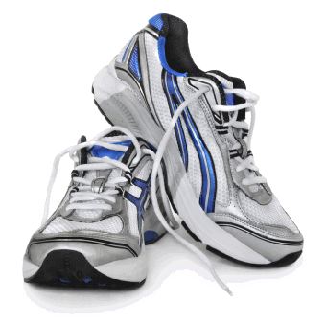
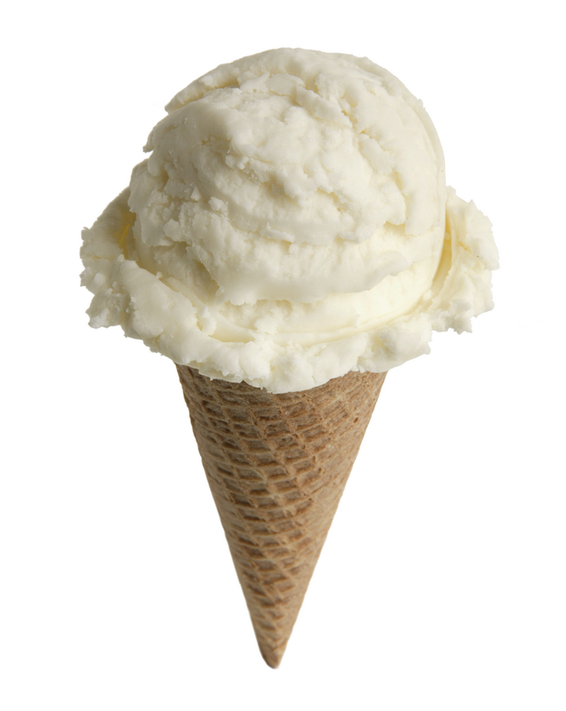
Minor symbols

Slide 2
The Christmas Lights are Ed’s way of making the Tatupu family feel acknowledged and welcomed. It’s a small gesture, not heroic or brave, but it means so much to them.
He realises from this act that small things can have a big impact. That the ordinary can be extraordinary and that behind the façade of an ordinary house there can be beauty and something special.
It also shows how a small gesture can mean the world to someone.
“Lua kisses her. Just softly on the lips. And she kisses back. Sometimes people are beautiful. Not in looks. Not in what they say. Just in what they are.” P 224
“Four globes to brighten up the Tatupu house this year. It’s not a big thing, but I guess it’s true – big things are often just small things that are noticed.” P 221
“This isn’t about words. It’s about glowing lights and small things that are big.” P 221

Slide 3
Have a think…. Has anyone ever done something like this for you? It might seem small to them but it made your day/week/year?
Or….
Have you ever done some thing like this for someone else? Not for the thanks, or the reward, just to make their day?
If you said no…. Why not? What’s stopping us?

Slide 4
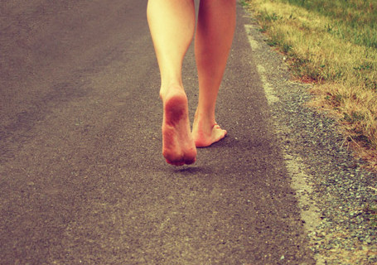
The Invisible Running Shoes
When Ed meets Sophie he can’t figure out what she needs.
When he sees her run, he sees her true beauty. She is happiest when she runs barefoot.
By giving her the invisible shoes he is giving her permission to be extraordinary, to run her races barefoot and enjoy it in the same way she does at 5.30am.
The shoes represent the fact that she had that ability all along, she just needed to be reminded of it. Each message Ed delivers lets him know the same thing.

Slide 5
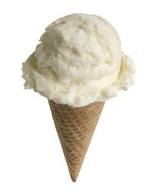
Angie Carusso’s icecream
Like the Christmas Lights, the icecream is a small gesture that has big effects.
Angie is a solo mum with small children. This is a demanding life with very little recognition.
Of course she loves her children, but in having them she has sacrificed a different possible life.
What does it mean that Ed gives her the icecream? What is he trying to say to her?

Slide 6
Dialogue
“It’s the person, Ma, not the place. If you left here, you’d have been the same anywhere else…. If I ever leave this place.. I’ll make sure I’m better here first.” P 283
“You are like he as… and just like him you were most likely to die the same way – a quarter of what you could have been… you see Ed, you were always an absolute no-hoper – just like your old man… and we’ve been employed to test you – to see if you can avoid this life.
“You were sent here to remind yourself that you don’t want to die the same way your father did. Understand?” p 348
“Yes, you’re here – and that’s exactly it!... Look at this dump. The house, the town, everything… your father – he promised me that one day we’d leave this place. He said we’d just pack up and go, and look where we are, Ed. We’re stil her. I’m here. You’re here, and just like your old man, you’re all promises, Ed, and no results… you could be as good as any of them… but you’re still here and you’ll still be here in fifty years… and you’ll have achieved nothing… I just want you… to make something of yourself.” P 245
“You know, they say that there are countless saints who have nothing to do with church and almost no knowledge of God. But they say God walks with those people without them ever knowing it… you’re one of those people, Ed. And it’s an honour to know you.” P 156
“Are you looking at a dead man now?” p351

