Slide 1
Theme A theme can be divided into two categories -Thematic concept and -Thematic statement Thematic concept is one word describing what readers think the text is about. A thematic concept is the basic idea , or ideas present within the text. For example , friendship, relationship, love etc. Thematic statement- is a sentence suggesting what the text says about the basic idea or subject you have identified . In order to create a thematic statement , you need to first get your thematic concept e.g.- friendship ( thematic concept/ idea) – then ask your self- ‘what does the text say about this broad issue ?’ Example Thematic concept- friendship Thematic statement – friends are a necessary part of human life

Slide 2
TASK
Thematic Concept | Thematic Statement
Fear | The only thing we have to fear is fear itself, in the novel I am the messenger by Markus Zusak , the character Ed is afraid of getting out there and doing anything, of taking a leap and actually living his life. He won't even tell his friend Audrey how he really feels about her, or talk to his buddies Ritchie and Marv about what's really going on in their lives.
Fate and free will | People have the ability to change their fate with the use of free will.
Identity | Our actions can influence our identity, it is only through our actions that we discover who we are as people
Love | There are various kinds of love that people experience on life’s journey
Disappointment | Not understanding ones' purpose in life can often lead to disappointment
Courage
Truth

Slide 3
Theme!
Recognising the extraordinary in the ordinary.
We all have something extraordinary about us, no matter where we are from or who we are.
We all have the potential to be extraordinary, it’s about taking hold of your life and making changes, while also taking pleasure in the little things.
Be kind, be active, take risks, don’t be a bystander. Ed’s life changes when he stops being a bystander and stops blaming other people for his own failures.
Success doesn’t always consist of commonly acknowledged achievements. Just small things…which are big.
What does this mean?

Slide 4
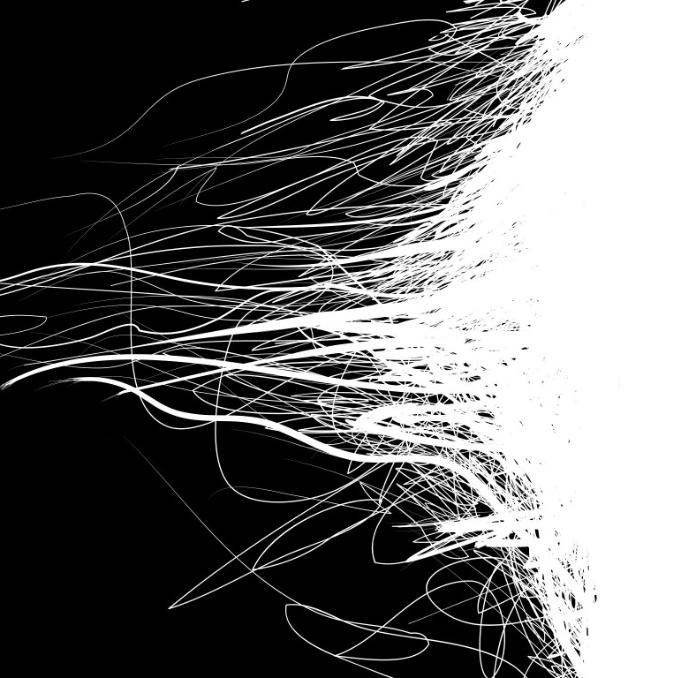
Imagery
Zusak uses the dark/light, day/night imagery repeatedly in the novel.
In the context of our theme and characters, what could that dark/light dichotomy represent?
And what are some examples that show it?

Slide 5
Imagery
Zusak’s repeated use of light and dark can be seen to represent good and evil as well as Ed movement from no hoper to someone with a purpose. He goes from being someone ordinary to recognising others and his own potential to be extraordinary.
For example, the fact that Ed chooses to face all of his earlier “cards” in the dark is a fact not to be overlooked; as the book progresses and Ed becomes more confident in his missions, more and more of his challenges are dealt with during the day.
Egs: “The sun is up – an orange cutout in a cardboard sky. I make it to the top and kneel down. My hands touch the cool stone.” One could say Zusak uses the idea of reaching the top of the rock face as the sun is rising as a symbol for the perseverance and determination of Ed in the novel.
This could also be seen as a reflection of Ed’s evolving conflicts and character in the novel – once dejected and relatively isolated, the sun is now “rising” from darkness, dawning on a new chapter in his life and possibly revealing the answer to the “cards” themselves.

Slide 6
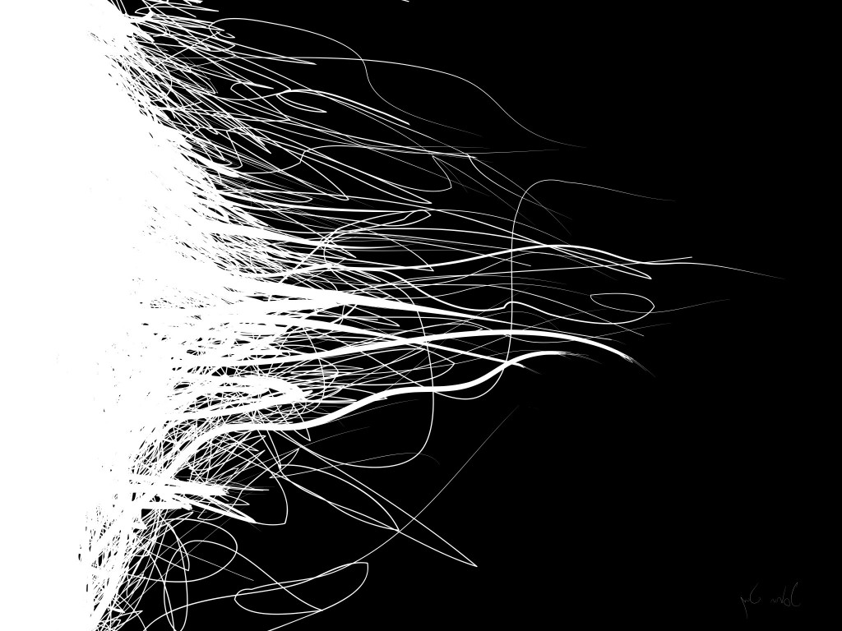
DARKNESS AND LIGHT QUOTES
“We sit in on the front steps, which are half in shadow, half in the sun. As it happens, I sit in the darkness and Tommy sits in the light… I’d wanted to stay on the porch with him until the sun shone bright on both of us, but I didn’t… I’d rather chase the sun than wait for it.” P 282-283
“I cant let him slink off to that darkness place inside him, where his pride is strewn all over the floor in some hidden room.” P 302
“I meet the darkness and uncertainty of what will come next. I feel the fear, but I walk fast toward it.” P 289
“The words stagger slowly from Marv’s mouth. Half his face is trodden with darkness, covered but I can still make out the outlines, the forms.” – p 317
“The first two hold me up with the rising of the sun.” p75
“God it’s dark now. As dark as the Ace of Spades.” P 245
“Each time a shudder makes its way to my arms and legs, I walk harder, deciding if Audrey needs me, and Ritchie and Marv, I have to hurry. Fear is the street. Fear is every step. The darkness grows heavier on the road and I begin. To run.” P290
“I wonder for a moment why I didn’t just set my alarm at home and come over at dawn, but I know I have to do this right. I had to suffer the night to do this properly.” – p333
“If my stomach was a colour, I think, it would be black, like tonight.” P 296

Slide 7
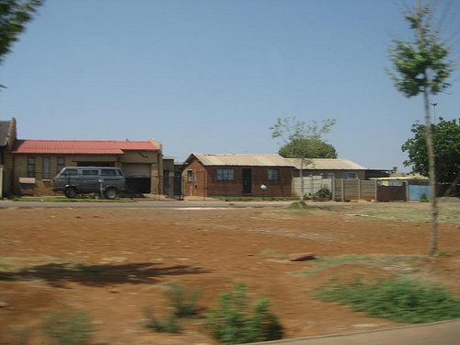
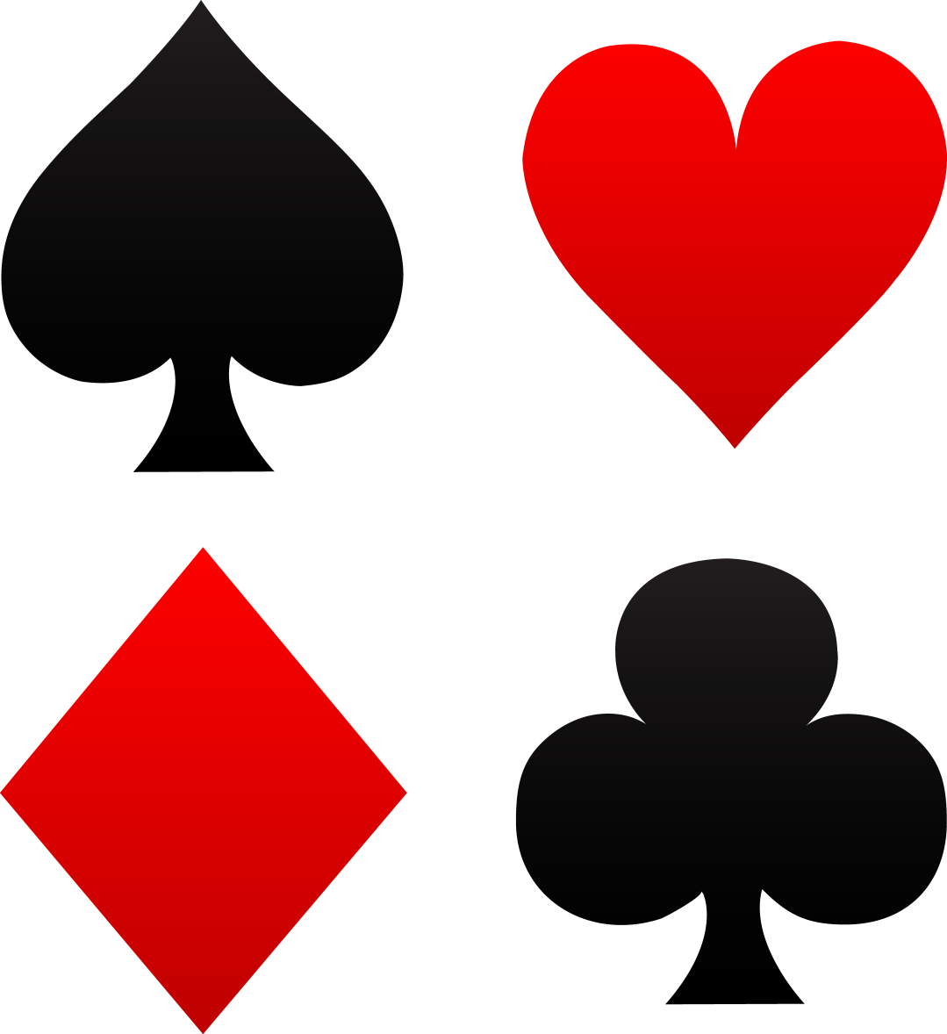
Major Symbols

Slide 8
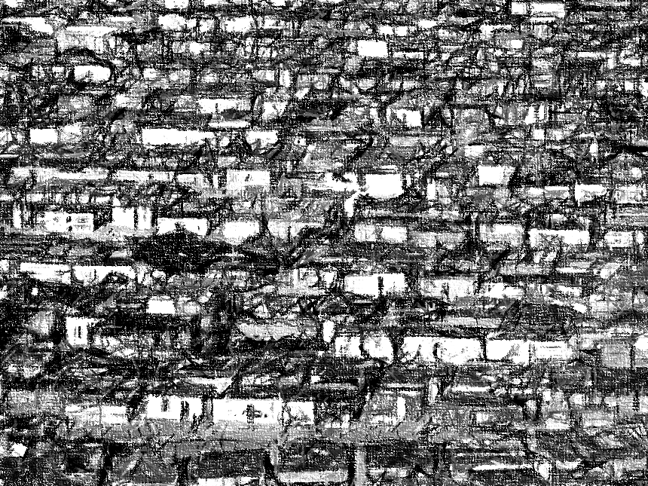
Symbolism - Ed’s neighbourhood (also counts as setting)
Ed lives is a town near Sydney, Australia. But his suburb could stand in for many in New Zealand, or any Western country, it’s an “every town” like the “everyman” in a virtue and vice story. Meaning it stands in for our own towns and neighbourhoods. It’s “run of the mill”.
“The town we all live in is pretty run of the mill. Its past the outskirts of the city and has good and bad parts. I’m sure it wont surprise you that I come from one of the bad parts. My whole family grew up at the far north of town, which is kind of like everyone’s dirty secret. There are plenty of teenage pregnancies there, a plethora of shithead fathers who are unemployed and mothers like mine who smoke, drink, and go out in public wearing ugboots.” P17

Slide 9
What does the neighbourhood symbolise?
It’s not the place, I think, it’s the people. We’d have been all the same anywhere else. P 245
“It’s the person, Ma, not the place. If you left here, you’d have been the same anywhere else…. If I ever leave this place.. I’ll make sure I’m better here first.” P 283
The neighbourhood represents our excuses and justifications for why we aren’t living the lives we should be. It allows us to let luck control our lives. Ed realises this and determines he will be better in his own home before leaving.
It also shows us that even in a place like this, heroes and extraordinary people and stories are happening.
Ed uses his neighbourhood as an excuse for his own failure. He blames it for his lack of motivation and focus.
Don’t use where you come from as an excuse for your ineptitude, your failure. Ed needs to recognise the ordinariness was him, not where he came from.

Slide 10
What does this mean?
What effect does it have if people around you are negative about your community, and you are too?
What message should we take from the novel about where we live and where we come from?

Slide 11
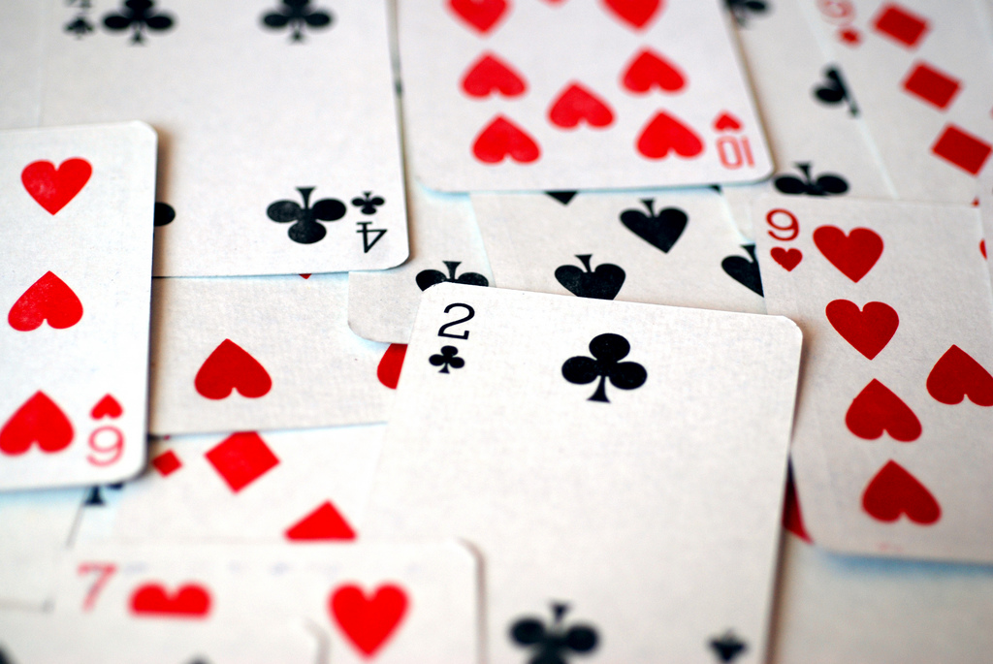
Symbolism
Talk to your neighbour:
What do playing cards represent in life? What associations do they have with them?
What could they represent in this book? (There may be more than one correct answer.)
Notes:
Luck – you might have bad luck but you can’t blame it forever
Chance
Gambling
Doing what you can with the cards you are dealt
Mastering life like you master a game of cards
Taking control – not letting the cards you receive be the end of the story
You need to take risks to get any reward

Slide 12
Annoyance
Symbolism -The card game
The 4 friends get together every week to play annoyance. What could this be symbolic of?
(Hint: think about the name…)

Slide 13
Playing cards quotes
“I was lying about throwing out the diamonds. No one in their right mind would throw diamonds out, would they? They’re valuable. If anything, they need protecting.” P70
“Protect the diamonds. Survive the clubs. Dig deep through the spades. Feel the hearts.”
“Later that night I look in the bathroom mirror. Two black eyes. Swollen jaw. A blood stream flowing to my throat… I stare strangely into the face of clubs.” P 180
“I imagine a full hand of aces in that drawer, fanned out as a player would hold them in a game. I never thought I wouldn’t want four aces. In a card game, you pray for a hand like that. My life is not a card game.” [ 117
“I have to dig. This is spades so I have to dig.” P214
‘People die of broken hearts.
They have heart attacks. And it’s the heart that hurts most when things go wrong and fall
apart.’ p 292
“I remember the diamonds, relive the clubs, and even smile about the spades. I worry about the hearts.” P 280

Slide 14
The messenger cards
Clearly the cards themselves are symbolic.
Ed says
“I imagine a full hand of aces in that drawer, fanned out as a player would hold them in a game. I never thought I wouldn’t want four aces. In a card game, you pray for a hand like that. My life is not a card game.” 117
This quote is slightly ironic… Ed’s life isn’t a card game, but it has been created by Zusak. While Ed had his cards dealt by the author he can still make changes and have an extraordinary life.
And if someone like Ed can do it… anyone can.
So the cards represent the life you are in, not what you can do. We are all dealt certain cards, but unlike Ed, we have full authorial authority over our own lives. And we need to take risks in order to move forward.

Slide 15
Structure
Symbolism -STRUCTURE
How is the book set out?
What does Zusak use to structure the novel?
Zusak structures the book around a deck of cards. Ed must work his way through each of the decks in order to fulfil his role and find meaning in his life. While most of us don’t have to take on a journey like Ed, Zusak is encouraging each of us to consider the various aspects the suits represent.
It’s also no coincidence that the cards are Aces – Aces are either the lowest or highest card in the deck.
Again, he reminds us that while Ed’s life is “a game of cards”, our own isn’t. We have full control of our lives. We are the author of our own lives, unlike Ed.
While we may have excuses, like Ed does, we can see that even someone who has been created to be useless can achieve extraordinary acts, then we can too.

Slide 16
Symbolism -Suits
In addition to the overall symbolism of the cards, the suits each have their own symbolism.
Your task: Identify what each suit represents. What was Zusak trying to do with the different meanings of the suits?

