Slide 1
I AM THE MESSENGER By Markus Zusak
angieville.blogspot.com

Slide 2
Major Characters
Ritchie
Marv
Audrey
Ed’s Father
Ed Kennedy
Doorman
Bank Robber
Bev (Ma)
Kennedy
Tommy
Kennedy
In your notebooks:
1. Identify each character
2. Explain each person’s relationship to Ed.
3. Give three facts about each character (four for Ed).
4. Copy one quotation for each person that best shows that character’s personality.

Slide 3
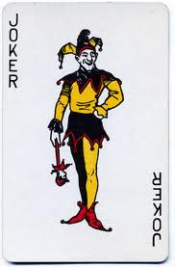
The Cards
protect the diamonds
survive the clubs
Say a prayer at the stones of home.
45 Edgar Street,Midnight
13 Harrison Street, 6 p.m.
6 Macedoni Street, 5;30a.m.
Graham Greene
Morris West
Sylvia Plath
The Suitcase
Cat Ballou
Roman Holiday
26 Shipping Street
For each card explain:
How Ed figured out what he was to do.
The conflict each person faced.
The conflicts Ed faced in dealing with the people and how he overcame them.
How Ed resolved the conflicts for the people.
dig deep through the spades
feel the hearts

Slide 4
Plot Diagram
Climax
(Turning Point)
Falling Action (Resolution)
(The conflict unravels)
Rising Action
(Complications)
Copy this diagram into your notebooks.
Outline the novel by filling in the important plot points.
Exposition
(Protagonist; antagonist; basic conflict; setting; inciting moment)
Denouement
(Conclusion)
25 points

Slide 5
Points to Ponder for Class Discussions
For each character on Slide 2, choose his/her main motivation from the following emotions: love, curiosity, self-preservation, self-satisfaction, greed, self-discovery, duty, revenge, other. Explain your choices with examples from book.
Choose a character in the book and analyze how he/she handled a situation. How would the character have to change to handle the situation in this way?
Describe the setting/locale and explain how it fits the characters and plot.
What is the central conflict/problem the protagonist is facing? Is it psychological, physical or both?
Choose one character and describe 3 ways the character’s personality is revealed (actions, words, others’ words, etc)
What is a symbol? List and analyze the symbols in this book.
Ed:
Discuss whether he was a believable character or not.
What did the author hope to accomplish by having Ed endure these experiences? Explain whether his method was madness or genius.
What changes do you expect Ed to make?
Should Ed have ended up with Audrey or was this a cop-out ending on the part of the author? Explain.

Slide 6
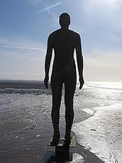
Quotations: (in groups of pairs): Find and copy quotations (include page numbers) that reveal Ed’s personality, conflicts and beliefs about himself and life.
classyclassical.com

Slide 7
If Ed is the message,
what
is he saying to
everyone who followed his saga?

