Slide 1
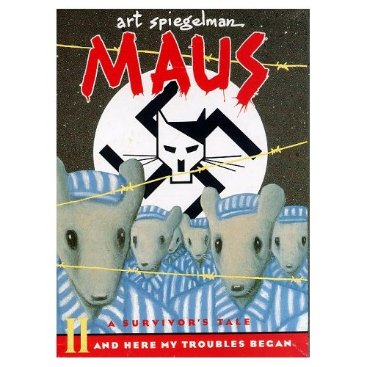
Introduction to Maus and Graphic Novels

Slide 2
Maus I—My Father Bleeds History Overview
Title: Maus I—My Father Bleeds History
Author: Art Spiegelman
Published: 1973 through 1991
Category:
Nonfiction
Graphic Novel
Memoir
Biography
Historical

Slide 3
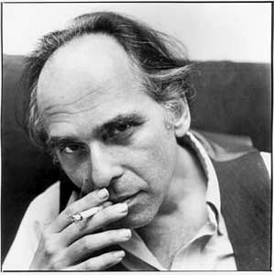
Maus I My Father Bleeds History
Art Spiegelman Born in 1948 in Stockholm, Sweden, Art Spiegelman is a naturalized U.S. citizen.
Lived with his parents in Rego Park in the Queens section of New York City.
From 1966 to 1989 he worked for Topps Chewing Gum, Inc. illustrating trading cards and stickers including the Garbage Pail Kids series.
He has written many comix (underground comics), worked as a New Yorker staff artist and writer, and been a lecturer and teacher at various times in his career.
His work has been the subject of special museum and gallery exhibits both in the U.S. and abroad. Maus earned him a special Pulitzer Prize.

Slide 4
Maus I—My Father Bleeds History Summary
Maus is a frame story, a story within a story.
Art Spiegelman, the son of two survivors of the Holocaust, tells how he interviewed his father Vladek about his Holocaust experience.
It tells the story of the father's persecution and survival. It is written in a comic book format, with various types of animals representing the various nationalities and religions.

Slide 5
Partner Share
What do you predict we might be able to gain from an eye-witness or first hand account that we could not from a second hand source, such as a textbook?

Slide 6
Maus I- Characters
Art(ie Spiegelman): | Author/Narrator & son of Vladek Spiegelman
Vladek Spiegelman: | Father of Art & Survivor of the Holocaust
Anja Spiegelman: | 1st wife of Vladek Spiegelman, mother of Art and Richieu.
Mala Spiegelman: | 2nd wife of Vladek Spiegelman, survivor of the Holocaust.
Francoise Mouly: | Wife of Art.

Slide 7
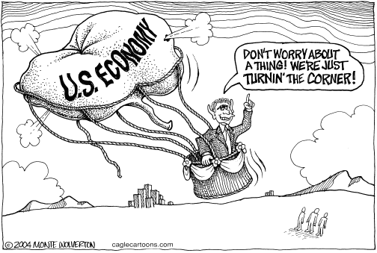
Visual Metaphor
Any visual symbol or picture that is used to represent something else. Visual Metaphors are often used in political cartoons.

Slide 8
List characteristics of a…
Hitler called them ‘vermin’.
They hid
They saved their food.
Small and insignificant.

Slide 9
List characteristics of a…
Cats kill and hunt down mice

Slide 10
List characteristics of a…
Loyal / rescuers
Dogs chase cats

Slide 11
List characteristics of a…
Hitler called them ‘pigs’.
followers
Lazy, indifferent
brutal, strong

Slide 12
Maus I—My Father Bleeds History General Characters
Maus I
The Jews are represented by mice.
The Germans are represented by cats.
The Americans are represented by dogs.
The Poles are represented by pigs.

Slide 13
Look at the pictures
Why do you think Spiegelman used animals for symbols rather than drawing humans?

Slide 14
"The Jews are undoubtedly a race, but they are not human.” –Hitler
Visual Metaphors in Maus: The depiction of characters
This quote is written on the copyright page of Maus, why do you think the author placed it there? _______________________________________________________________________________________________________________________________________________________________________________________

Slide 15
Graphic Novels
A novel with images similar to a comic book. Graphic novels are longer than an ordinary comic book and tend to deal with more serious issues.
Text & illustrations present information
Book-length, usually contain one story
Medium, not genre

Slide 16
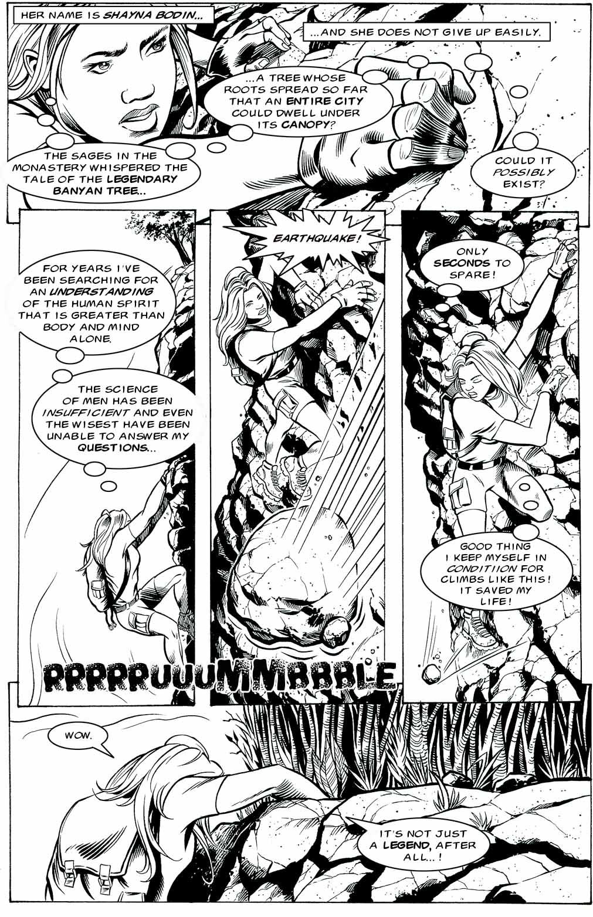
Caption
Panel
Gutter
Thought Balloon
Sound Effect
Dialog Balloon

Slide 17
Elements of a Graphic Novel
Pages consist of a variety of elements
Panels-squares or rectangles that contain a single scene
Gutters-space between panels
Dialogue Balloons-contain communication between/among characters
Thought Balloons-contain a character’s thoughts
Captions-contain information about a scene or character
Sound Effects-visual sound clues i.e.. Wonk! Pow!

Slide 18
How to Read a Graphic Novel Page
Graphic novels are read left to right, just like traditional texts

Slide 19
Dialogue Balloons
Dialogue balloons are read left to right or top to bottom as is appropriate.
1
4
2
3
5

Slide 20
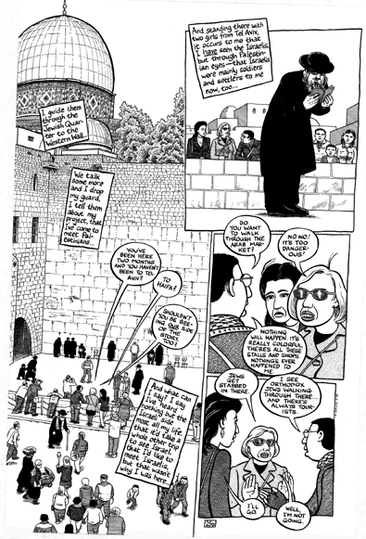
Sometimes it can get a little more complicated…

Slide 21
But the basic left to right rule still applies to panels
2
1
3
4

Slide 22
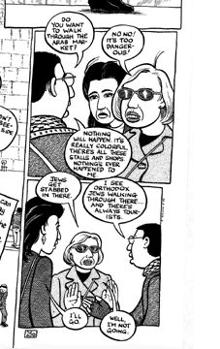
2
…and dialogue balloons as well
1
3
4
5
6
7

